Slide 1
Hydrodynamic Entropy in
Deep Neural Networks
AlexNet · VGG-16 · VGG-19 · GraphCast Small · Operational · Full

Slide 2
Overview & Motivation
Why apply turbulence theory to neural networks?
Wavenumber k
Both turbulent flows and deep networks process information across multiple spatial scales simultaneously.
Kolmogorov described how energy cascades from large eddies (low wavenumber) to small eddies (high wavenumber) via a power law E(k) ~ k^(-5/3).
Convolutional layers build progressively larger receptive fields — a perfect analogy for spatial scale.
Measuring how energy (mean squared weights) is distributed across scales reveals hidden structure in learned representations.
The hydrodynamic entropy S_H = -Σ p_i log₂(p_i) quantifies multi-scale balance in a single interpretable number.
1/R_receptive_field — larger k = finer spatial detail interrogated by the network
Modal Energy E(k)
mean(W²) per layer — how much learned energy is invested at each scale
Entropy S_H
-Σ p_i log₂(p_i) where p_i = E_i / ΣE — uniformity of multi-scale energy
Kolmogorov Law
E(k) ~ k^(-5/3) — the benchmark turbulence reference (α = -1.667)

Slide 3
Mathematical Framework
Receptive Field Growth
Interpretation
R_out = R_in + (k − 1) × jump
S_H = 0 → all energy in ONE scale (maximally ordered)
S_H = S_max → energy perfectly uniform across all scales
Low S_H/S_max → concentrated, scale-biased learning
High S_H/S_max → balanced multi-scale representation
Kolmogorov α = −5/3: turbulent reference for power-law comparison
Positive α: energy rises toward fine scales (anti-turbulent)
Negative α near −5/3: near-turbulent spectral cascade
where k = kernel size, jump = product of all preceding strides
Energy per Scale
E(k) = mean(W²) per layer
CNNs | or | mean ||W·x||² per mesh level (GNNs)
Hydrodynamic Entropy
p_i = E_i / Σ E_j
S_H = −Σ p_i · log₂(p_i)
S_max = log₂(N_layers) | Normalised = S_H / S_max

Slide 4
Section 1
CNN Image Classifiers
AlexNet · VGG-16 · VGG-19 — Receptive Field & Weight Energy Analysis

Slide 5
AlexNet — Architecture & Receptive Field Growth
5 conv layers | Aggressive early stride | Max RF = 163 px
Layer | Type | Kernel | Stride | RF (px)
conv1 | Conv | 11×11 | 4 | 11
pool1 | MaxPool | 3 | 2 | 19
conv2 | Conv | 5×5 | 1 | 51
pool2 | MaxPool | 3 | 2 | 67
conv3 | Conv | 3×3 | 1 | 99
conv4 | Conv | 3×3 | 1 | 131
conv5 | Conv | 3×3 | 1 | 163
11×11 at Stride 4
Unusually large initial kernel creates coarse 4-pixel jumps, rapidly expanding receptive field from 1 to 11 px in one step.
163 px Max RF
After 5 conv + 3 pool layers, the final convolution sees a 163×163 pixel region of the input image.
Scale Jumps
Stride-4 + MaxPool combinations create discontinuous scale jumps rather than the smooth growth seen in VGG.

Slide 6
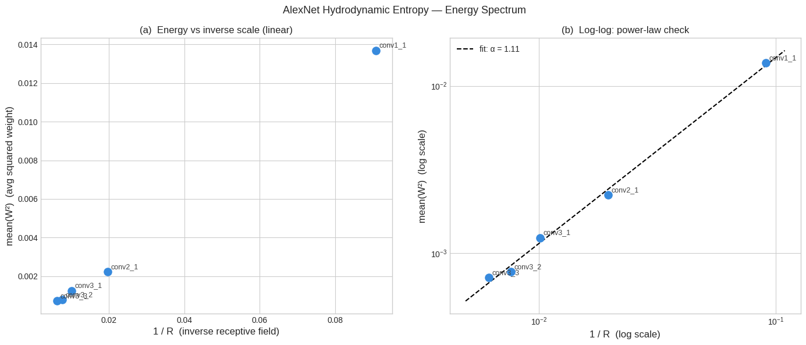
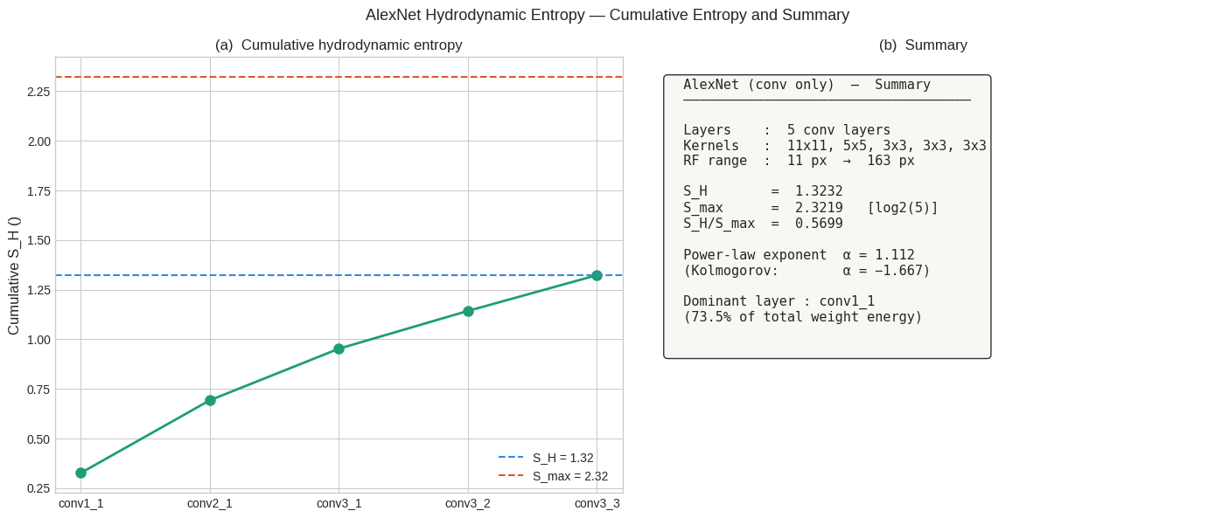
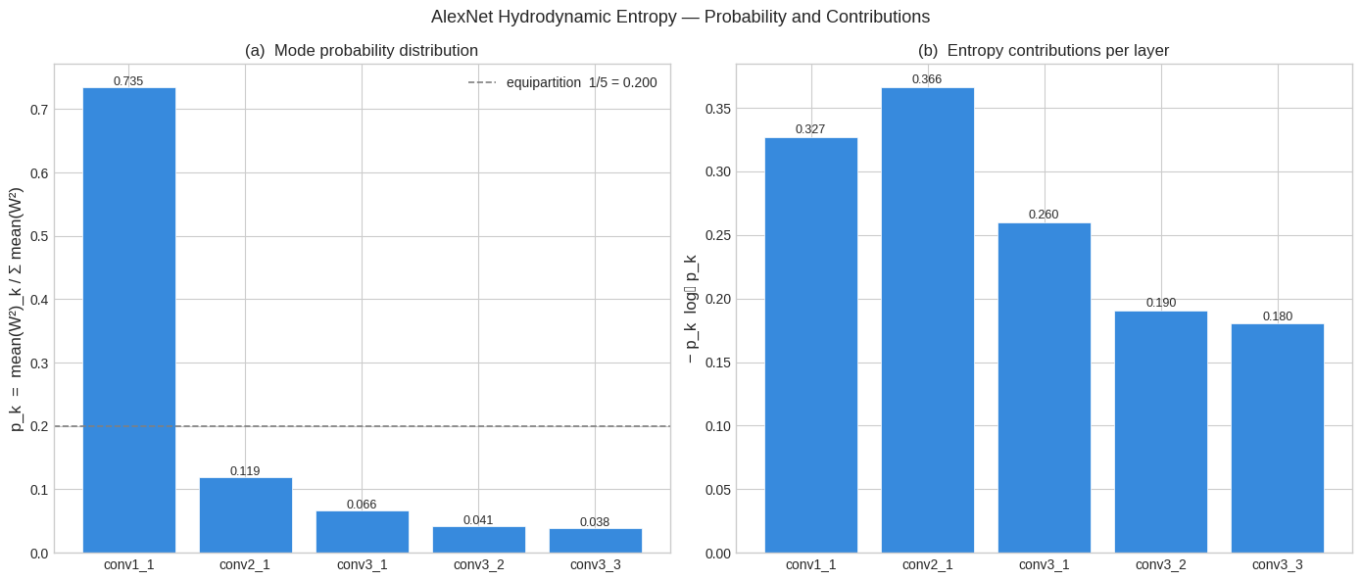
AlexNet — Architecture & Receptive Field Growth

Slide 7
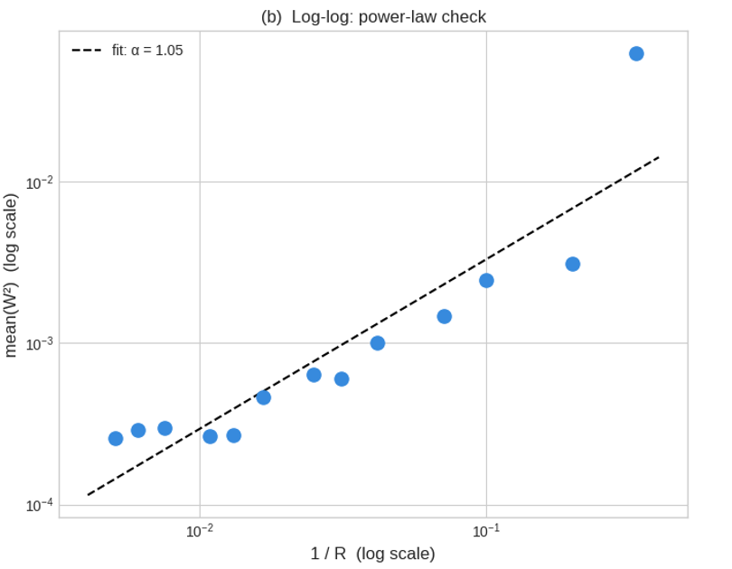
VGG-16 — Architecture: 13 Conv Layers, All 3×3 Kernels
Architecture: 2+2+3+3+3 conv layers across 5 blocks | Max RF = 196 px
Layer | RF (px)
conv1_1 | 3
conv1_2 | 5
pool1 (2,s2) | 6
conv2_1 | 10
conv2_2 | 14
pool2 (2,s2) | 16
conv3_1–3_3 | 24–40
pool3 (2,s2) | 44
conv4_1–4_3 | 60–92
pool4 (2,s2) | 100
conv5_1–5_3 | 132–196

Slide 8
VGG-16 — Energy Distribution & Hydrodynamic Entropy
1.067
3.700
28.8%
+1.052
>70%
S_H
S_max log₂(13)
S_H / S_max
Power Law α
Energy in Layer 1
Key Observations
conv1_1 alone holds ~70.4% of total network energy — an extraordinary concentration at the finest scale (R=3 px).
Normalised entropy of 28.8% is far below 0.5, confirming a highly ordered, non-uniform distribution.
Power-law exponent α = +1.052 is POSITIVE — energy rises toward finer scales, the opposite of Kolmogorov turbulence.
The network is 'anti-turbulent': it encodes most of its learned representation in low-level edge detectors.
Deeper layers (60–196 px RF) contribute negligibly to the energy budget despite having many more parameters.

Slide 9
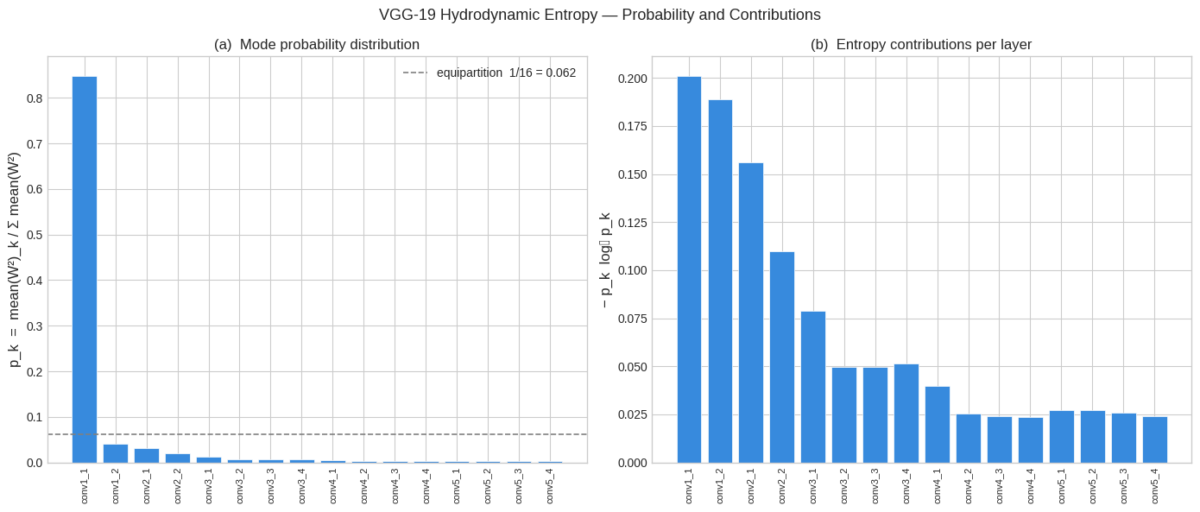
VGG-19 — Extension & Comparison
16 conv layers | Adds 1 extra conv to blocks 3, 4, 5 | Max RF = 252 px
1.103
4.000
27.6%
252 px
S_H
S_max log₂(16)
S_H / S_max
Max RF
VGG-19 adds 3 layers but barely changes the energy profile — S_H rises by only 0.036.
Both models remain in the same qualitative regime: extreme fine-scale concentration.
Additional depth slightly broadens the distribution but does NOT shift the dominant scale.
The architecture family is robustly anti-turbulent regardless of depth.

Slide 10
CNN Summary — Energy Concentration at Fine Scales
CNN Conclusions
All CNNs are ANTI-TURBULENT: positive power-law α means energy rises toward fine scales (small R).
Normalised S_H < 30% — extreme scale bias concentrated in the first 1–2 layers.
Depth (VGG-16 → VGG-19) marginally broadens the distribution but does not change the qualitative regime.
The architecture encodes learned features primarily as low-level edge/texture detectors at 3–14 px receptive fields.

Slide 11
Section 2
GraphCast — GNN Weather Models
GraphCast Small · GraphCast Operational · GraphCast Full
Geometric Energy Spectra on Icosahedral Meshes

Slide 12
GraphCast — Global Weather Forecasting via GNNs
Google DeepMind (2023) | Trained on ERA5 reanalysis | 6-hour forecast step
Grid2Mesh Encoder
Mesh GNN Processor
Mesh2Grid Decoder
Maps atmospheric state (temperature, wind, geopotential) from a regular lat-lon grid to icosahedral mesh nodes. Encoder weight W[4×512] projects 4D geometric edge features.
16 message-passing steps on the multi-resolution icosahedral mesh. Each step propagates information across ~327K edges (Full model).
Projects processed mesh embeddings back to the lat-lon grid to produce forecast outputs for all atmospheric variables.
Checkpoint | Resolution | Levels | Mesh | Total Edges | Training Data
GC Small | 1.0° | 13 | M0–M5 (6) | 81,900 | ERA5 1979–2015
GC Operational | 0.25° | 13 | M0–M6 (7) | 327,660 | ERA5-HRES 1979–2021
GC Full | 0.25° | 37 | M0–M6 (7) | 327,660 | ERA5 1979–2017

Slide 13
Icosahedral Mesh Structure & W·x Energy Method
Mesh hierarchy — Full & Operational models (mesh_size=6, M0–M6)
Level | Scale (km) | n_edges
M0 | 10,008 | 60
M1 | 5,004 | 240
M2 | 2,502 | 960
M3 | 1,251 | 3,840
M4 | 625 | 15,360
M5 | 313 | 61,440
M6 | 156 | 245,760
W·x Projection
x = Edge geometry vector
(4 features per edge)
W shape: [4 × 512]
Encoder weight matrix
(shared across levels)
Projection:
W·x → [n_edges, 512]
Energy E(k):
mean ||W·x||²
per mesh level

Slide 14
GraphCast Energy Spectra — W·x Mean Per Edge
Key Result: All 3 models nearly identical
M0 dominates with ~4.3–4.6 E(k).
Energy decays geometrically
GC Small, Operational, and Full curves are nearly superimposed despite different depths.
Power law decay is consistent with turbulent cascade (negative α ≈ −1.85).

Slide 15
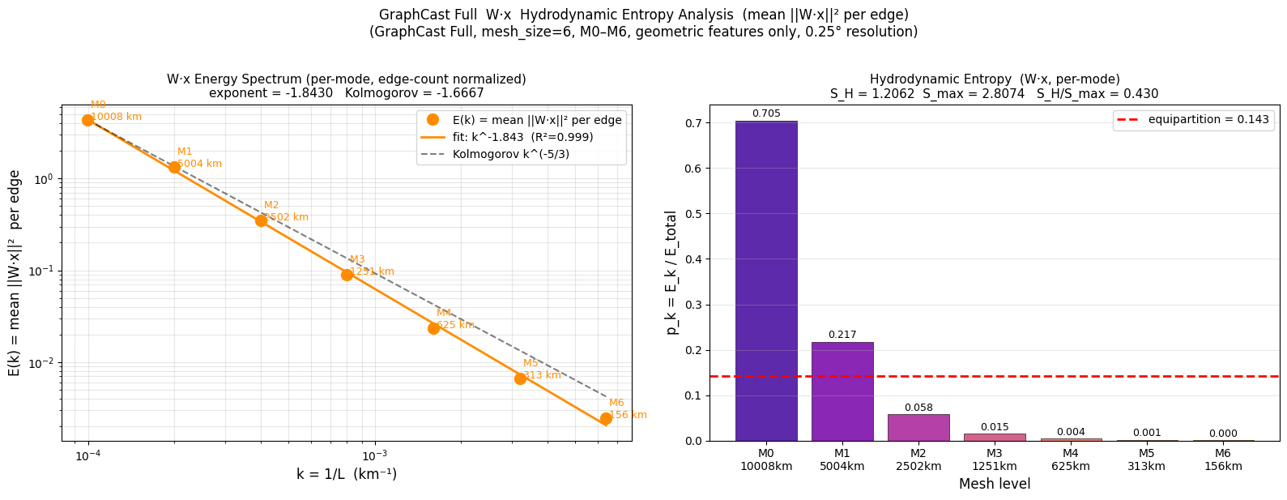
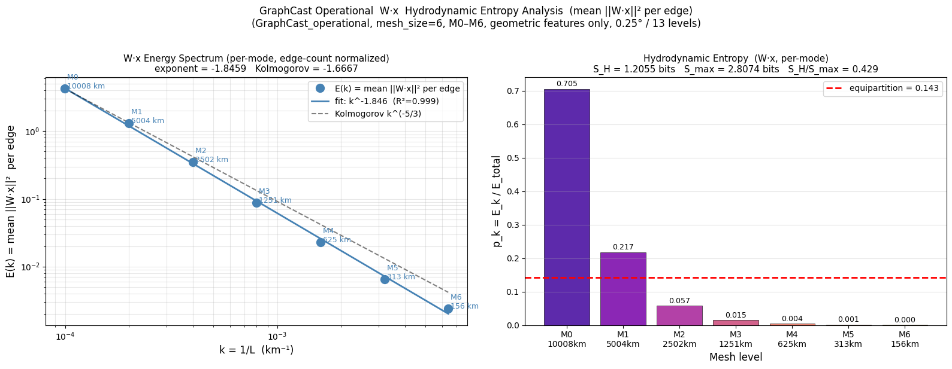
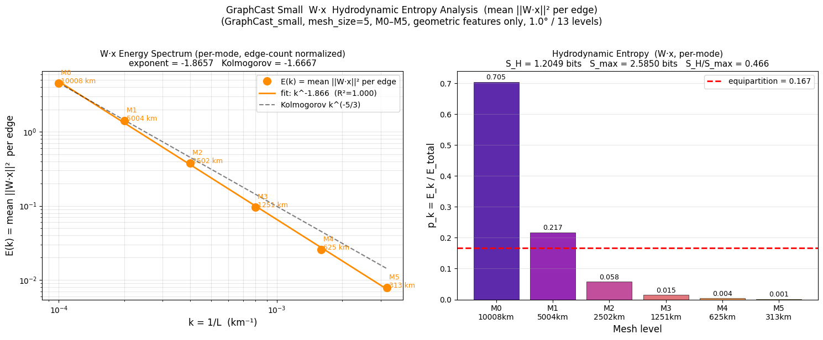
GraphCast Energy Spectra — W·x Mean Per Edge

Slide 16
GraphCast — Hydrodynamic Entropy Across Checkpoints
1.205
1.206
1.206
−1.85
GC Small S_H
GC Operational S_H
GC Full S_H
Average α
Entropy Findings
S_H values across all 3 checkpoints differ by only 0.001 — essentially identical.
GC Small normalised: S_H/S_max = 46.6% (6 levels).
GC Operational & Full: S_H/S_max ≈ 43.0% (7 levels).
Power-law R² > 0.998 across all models — excellent power-law fits.
M0 consistently holds ~70.5% of energy across all checkpoints.

Slide 17
Power-Law Exponents — GraphCast vs Kolmogorov
Near-Kolmogorov Scaling
All three models produce α in the tight range −1.843 to −1.866.
Kolmogorov reference: α = −5/3 ≈ −1.667 (turbulent inertial range).
GraphCast exponents are ~0.18 steeper than Kolmogorov, not equal.
R² > 0.998 confirms excellent power-law fit across 5–6 decade-spanning mesh levels.

Slide 18
Section 3
Cross-Architecture Comparison
CNN Image Classifiers vs GraphCast GNN Weather Models
Two Opposite Energy Regimes

Slide 19
Two Energy Regimes: Anti-Turbulent CNNs vs Near-Turbulent GraphCast
CNN Image Classifiers
GraphCast GNNs
Property | CNNs (AlexNet/VGG) | GraphCast (GNNs)
Dominant scale | Finest (R=3–11 px) | Coarsest (L=10,008 km)
Power law α | +1.052 (positive) | −1.84 to −1.87 (negative)
Turbulence analogy | Anti-turbulent (inverted) | Near-turbulent cascade
S_H / S_max | ~28% (highly ordered) | ~43–47% (moderate)
M0/Layer1 energy | >70% in layer 1 | ~70.5% at M0
Physical meaning | Bottom-up feature build | Top-down global dynamics

Slide 20
S_H Comparison Across All Six Architectures
Pattern Analysis
All architectures show low S_H relative to their S_max — none is fully scale-balanced.
CNNs (VGG-16, -19) have slightly lower absolute S_H than GraphCast models.
GraphCast variants differ by only 0.001 — remarkable consistency across checkpoint scale/depth.

Slide 21
Key Conclusions
Six architectures. Two domains. One framework. Universal scale-bias in deep learning.
+1.05
−1.85
28–47%
~70%
CNN Power Law α
(Anti-Turbulent)
GC Power Law α
(Near-Turbulent)
S_H/S_max Range
All Models
Energy in
Dominant Scale
Hydrodynamic entropy S_H provides a rigorous, interpretable scalar for comparing energy distribution across any deep network.
CNN image classifiers are anti-turbulent: energy concentrates at fine scales (R=3–11 px) with positive power-law exponents (+1.05).
GraphCast GNNs are near-turbulent: energy decays from planetary scale (M0) following α ≈ −1.85, close to Kolmogorov −5/3.
All six architectures share one universal feature: ~70% of energy in a single dominant scale, regardless of domain or depth.
GraphCast's spectral shape is robust across Small / Operational / Full checkpoints
This framework is extensible to Transformers, ResNets, diffusion models, and any architecture with assignable spatial scales.

Slide 22
Thank You
Questions & Discussion

